Slide 1


Predicting Customer Bookings
Machine Learning Model & Strategic Recommendations to Identify High-Intent Customers and Prevent Booking Abandonment

Slide 2





Executive Summary & Key Metrics
50,000
15.0%
0.757
0.765
BOOKINGS ANALYSED
COMPLETED BOOKING RATE
5-FOLD CV ROC AUC
TEST-SET ROC AUC
Key Finding
Customer booking origin and route demand popularity serve as the primary indicators of booking completion. Surprisingly, checkout add-ons (extra baggage, seat selection, and in-flight meals) hold significantly lower predictive power regarding overall conversion.

Slide 3

Business Problem & Class Imbalance
Challenge Overview
High Severe Class Imbalance: Only 15.0% of user sessions culminate in a completed booking, leaving 85.0% uncompleted.
85 / 15 Imbalance Strategy
To prevent bias toward the majority class, we implemented class-weighted Random Forests (300 estimators) paired with stratified cross-validation.
Standard Model Fallback: Off-the-shelf algorithms tend to predict all sessions as non-bookings without tailored loss weighting.
This ensured optimal discrimination sensitivity between completed and abandoned user sessions without synthetic over-sampling artifacts.
Strategic Goal: Early detection of high-potential abandoners to enable personalized nudges and conversion recovery.

Slide 4






Feature Engineering Pipeline
Demand & Route Popularity
Log-Scaled Time Dynamics
Service & Behavioral Indicators
Engineered aggregate demand features capturing historical route traffic and origin market popularity scores to represent underlying booking intent.
Applied logarithmic transformations to Purchase Lead Time and Length of Stay to dampen extreme skews and isolate non-linear response curves.
Constructed aggregated counts for requested extras (baggage, seats, meals) along with binary indicator flags for red-eye and weekend flight schedules.

Slide 5
Model Strategy & Validation
Model Component | Technical Configuration | Performance Impact / Outcome
Algorithm | Random Forest Classifier (scikit-learn) | Captures non-linear feature interactions efficiently
Ensemble Hyperparameters | 300 Decision Trees with balanced class weighting | Protects model against 85/15 class imbalance bias
Cross-Validation | 5-Fold Stratified Cross-Validation | Achieved consistent training ROC AUC of 0.757
Test Verification | Held-out 20% unseen test dataset | Confirmed generalizability with ROC AUC of 0.765

Slide 6
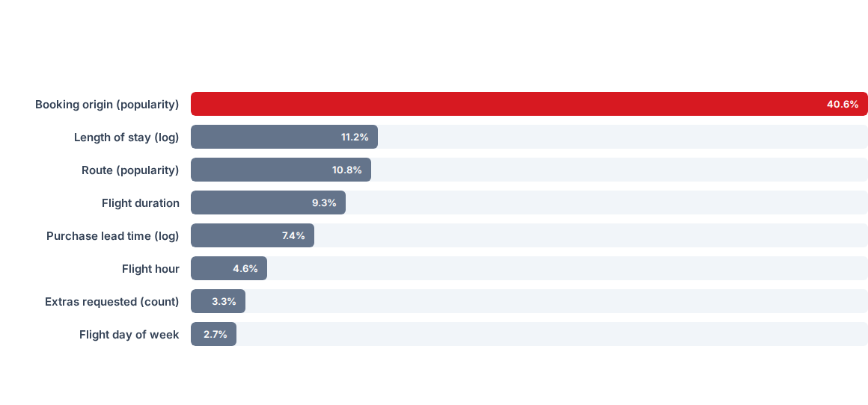
Key Drivers of Customer Booking
Relative feature importance calculated from the trained Random Forest ensemble model:

Slide 7


Origin & Demand Signal Takeaways
Strategic Takeaways
Geography Trumps Add-ons: Where a customer initiates a search from (40.6%) outweighs checkout customization options like baggage or meals (3.3%).
Trip Intent Signals: Length of stay (11.2%) combined with lead time (7.4%) reflect whether the user is a committed business traveler or an exploratory leisure browser.
Actionable Focus: Resources should focus on front-end funnel customization rather than late checkout upselling.

Slide 8




Strategic Recommendations
Localize Market Flow
Real-Time Session Nudges
Streamlined Checkout
Tailor the booking interface by origin country—offering preferred local currencies, popular payment channels, and region-specific support upfront.
Deploy real-time predictive scoring. Flag high-risk, low-probability sessions on high-demand routes for immediate retention prompts or save-and-return emails.
Reduce conversion friction for high-intent origins by auto-populating frequent travel fields and offering simplified, one-click checkout flows.

Slide 9




Implementation Roadmap
Model Deployment
Market Adaptation
Nudge Automation
A/B Evaluation
Integrate Random Forest inference API into the web booking engine backend.
Launch localized payment and currency options for top 10 origin markets.
Implement triggered abandonment emails & live session retention popups.
Measure conversion uplift across target routes and refine scoring algorithms.

Slide 10

Questions & Discussion
Predicting Customer Bookings — British Airways Data Science Task 2

Slide 11

Image Sources
https://images.unsplash.com/photo-1744451620884-630219cbf017?fm=jpg&q=60&w=3000&auto=format&fit=crop&ixlib=rb-4.1.0&ixid=M3wxMjA3fDB8MHxwaG90by1wYWdlfHx8fGVufDB8fHx8fA%3D%3D
Source: unsplash.com

